Slide 1
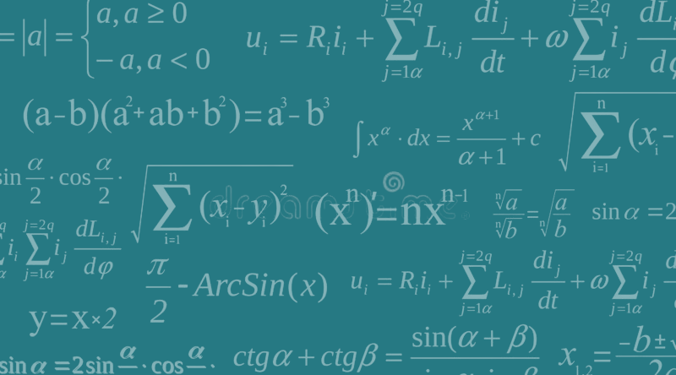
Theorem /Formula
the number of theorems must be less than one billion.
a formula, or statement

Slide 2



PYTHAGORAS THEOREM
a2 + b2 = c2
UmairSolangi

Slide 3


DEMONS
BADSHAH

Slide 4
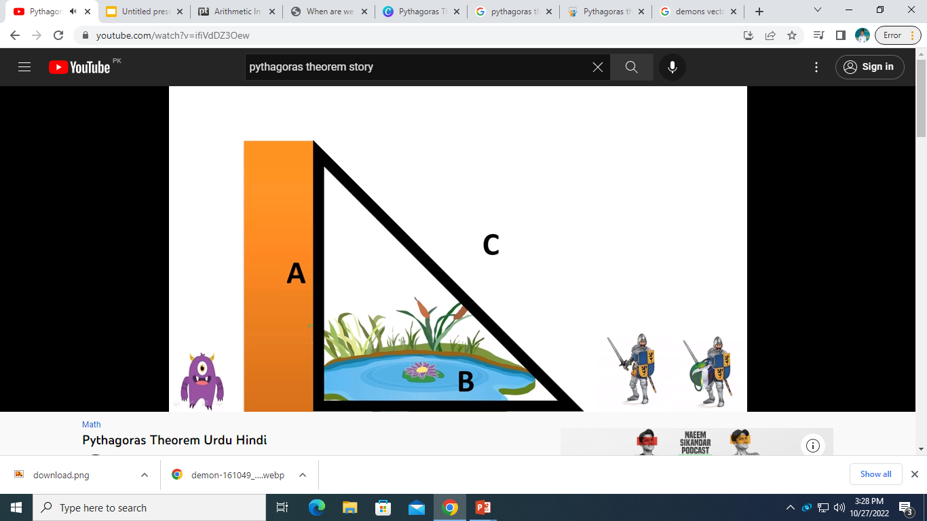
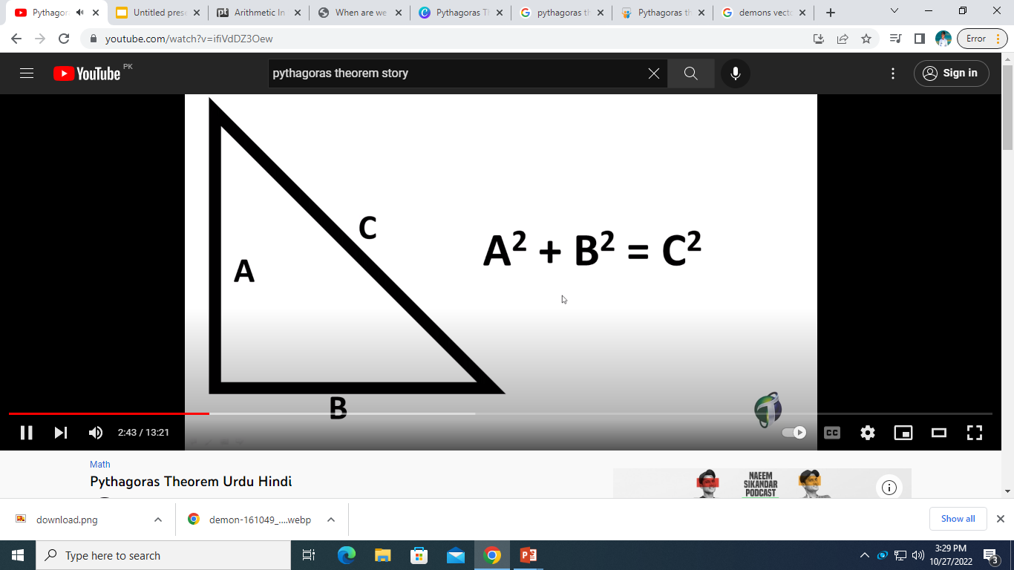

Slide 5
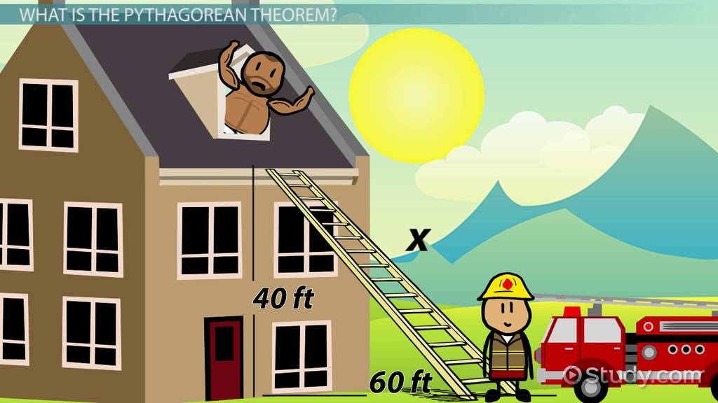

Slide 6
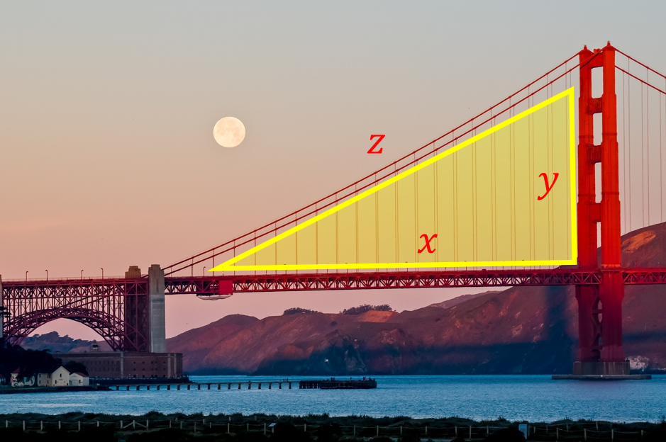

Slide 7
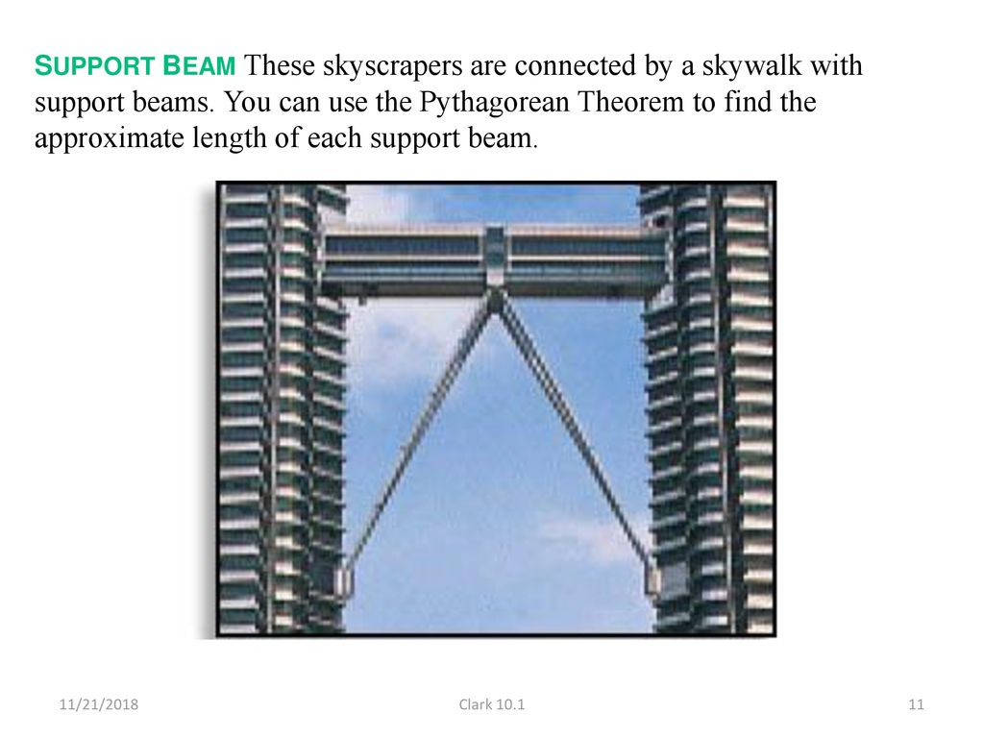

Slide 8
END
THANK YOU
UMAIRSOLANGICEO

